Slide 1
AA ML Course – Theoretical Session #1
December, 2016
Avrahami Israeli
Notes:
Few important things before starting:
Introduce myself
The level of the session will be according to the weakest link in the chain
I don’t except any prior knowledge – besides very basic one
There is no real separation between data prep an data understanding – some of the topics will be relevant to both
Don’t hesitate to ask ANY question – there is no stupid question for the next 3 hours
I’ll do my best to link things to the practical world and not stay only in the theoretical one
We’ll have 2 breaks of 10 min each after 50 min
Let’s start with your intuition about data prep and data undersetting - write on board

Slide 2
Agenda
Introduction
Data types
Distance measures
Correlation and Mutual information
Data distribution
Missing values
Outliers
Normalization & Transformation
Discretization
Unbalanced data

Slide 3
Introduction (1)
Today - the first part of the CRISP-DM (and most important one!)
What is NOT going to be covered here
Statistical session VS ML ‘hard core’ session
Not all topics involve heavy theoretical material
Notes:
Not going to be covered – advanced algorithms and advanced data understanding
The data understating part is not something we can define real limits to. It is not a model we are running and get results – it is a factor of time, resources and importance to the project

Slide 4
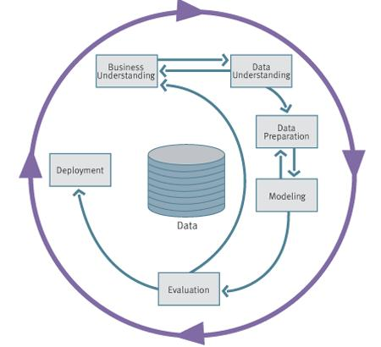
Introduction (2) - CRISP-DM
CRISP-DM breaks the process of data mining into six major phases
Business Understanding
Data Understanding
Data Preparation
Modeling
Evaluation
Deployment
The sequence of the phases is not strict and moving
back and forth between different phases may be required
Notes:
The sequence of actions along the data prep is not deterministic – we can do some steps before others
Part of the data prep is also the feature selection /feature creation/PCA etc…. - this will be covered on the another session

Slide 5
Introduction (3)
Why is data preprocessing important?
“Garbage in → Garbage out”
No quality data – no quality mining results!
Irrelevant data
Redundant data
Too much data (e.g. outliers, curse of dimensionality)
Data representation (e.g. - zip-code)
Notes:
Zip code as a number has no real meaning – on the other side, taking it to be a categorical feature may help us a lot
Give examples for each one of the items

Slide 6
Introduction (4)
Major tasks in data preprocessing
Data cleaning (e.g. missing values handling)
Data transformation (e.g. normalization)
Data discretization
Data reduction

Slide 7
Agenda
Introduction
Data types
Distance measures
Correlation and Mutual information
Data distribution
Missing values
Outliers
Normalization & Transformation
Discretization
Unbalanced data

Slide 8
Data types (1)
Type
Numerical data (double)
Numerical data (int)
Boolean
Categorical data
Ordinal data
Others
Example
Income (e.g. 650.34)
# of children (e.g. 4)
Gender (e.g. male)
Colors (e.g. green)
Satisfaction (e.g. 2/5)
Comments
Notes:
Why is it important here? Think about tasks like distribution analysis
With some of the types, we wont be able to use some measures/algorithms.
Determine the data type IS NOT so simple some times – e.g. some feature you get has values like 22, 23, 27 – int/numeric/factor?

Slide 9
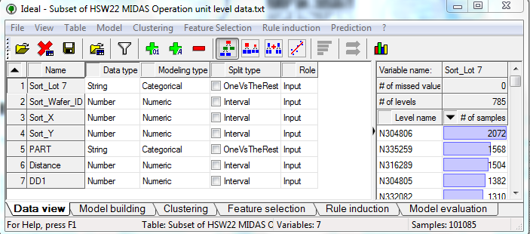
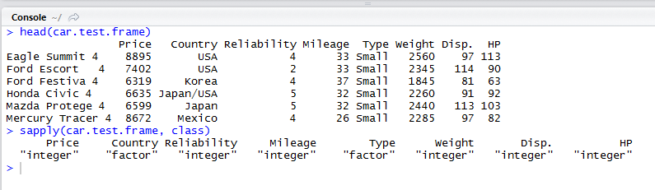
Data types (2)
Why is it so important ??
A-normal input for modeling
Distance measures
Models results are based on this input
Notes:
דוגמא מס' 1 ב R

Slide 10
Agenda
Introduction
Data types
Distance measures
Correlation and Mutual information
Data distribution
Missing values
Outliers
Normalization & Transformation
Discretization
Unbalanced data

Slide 11
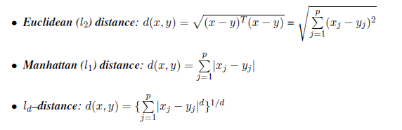
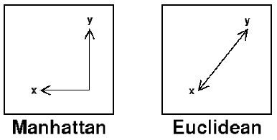
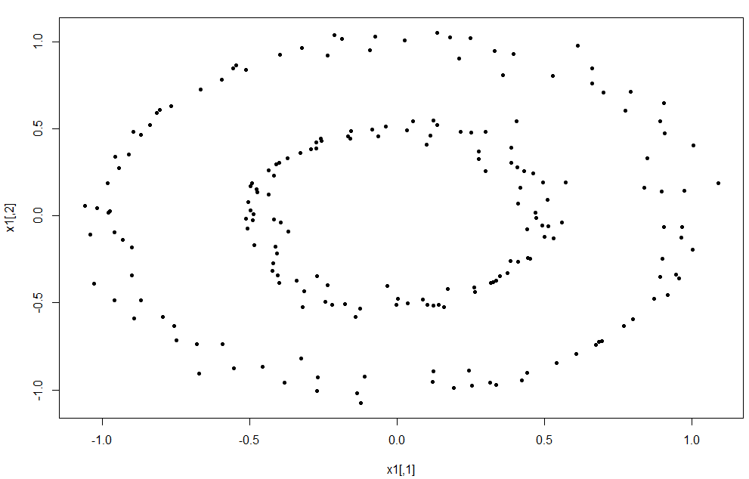

Distance Measures
Distance measure most satisfy some basic rules ( e.g. $d\left(x,y\right)≥0$ )
Distance measure examples:
Related examples: K-means, K-nn, Recommendation System algorithms
Let’s have a look in R to see why it is critical
Notes:
לדבר גם פונקציית מרחק במשתנים קטגוריילים
דוגמא מס' 2 ב R

Slide 12
Agenda
Introduction
Data types
Distance measures
Correlation and Mutual information
Data distribution
Missing values
Outliers
Normalization & Transformation
Discretization
Unbalanced data

Slide 13
Correlation
Definition: Correlation refers to any of a broad class of statistical relationships involving dependence
How is this related to our discussion ?
Where else will we use these measures?
Most common correlations:
Pearson Correlation – measures the degree of linear dependence between two variables
Spearman correlation – measures how well the relationship between two variables can be described using a monotonic function
Kendall's tau correlation - measures the “ordering” dependency between two variables
Notes:
זה קשור לעולם שלנו כרגע כי באופן מיידי נרצה למצוא תלויות בין משתנים מסבירים ובין משנה מסביר למוסבר – השאלה איך מגדירים קשר...
נשתמש בהגדרות אלו גם בהמשך כמדד לטיב ההתאמה של מודל מסוים

Slide 14
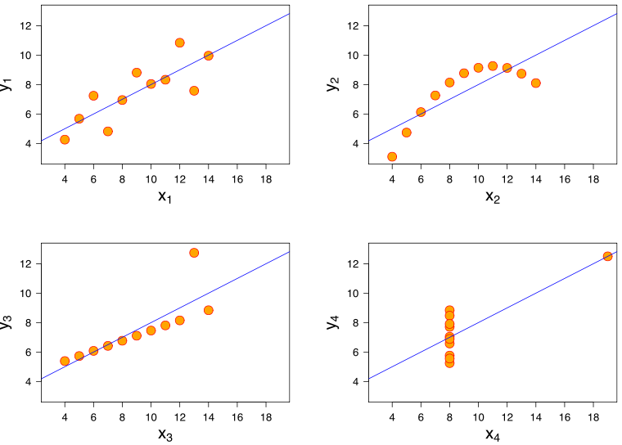
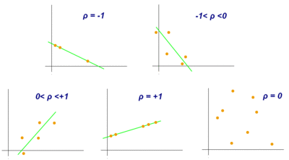

Pearson Correlation
Measures the linear relationship between two features
Definition : $ρ_{X,Y}= \frac{Cov\left(X,Y\right)}{SD\left(X\right)∗SD(Y)}= \frac{σ_{xy}}{σ_{x}σ_{y}}$
Sample Correlation def. : $r_{X,Y}= \frac{\sum_{i=1}^{n}{\left(x_{i}−\overline{x}\right)}(y_{i}−\overline{y})}{\sqrt{\sum_{i=1}^{n}{{\left(x_{i}−\overline{x}\right)}^{2}}}∗\sqrt{\sum_{i=1}^{n}{{\left(y_{i}−\overline{y}\right)}^{2}}}}$
$r_{(X,Y)}=r_{(a+bX , c+dY)} ∀a,b,c,d∈R$
Range: [-1,1] (what does the -1,0,1 values mean?)
$r_{(X,Y)}=0\underset{⇔}{??}Uncorrelated \underset{⇔}{??} Independent$
What is the relation to linear regression?
Notes:
* מדוע אי קורלציה לא גוררת אי תלות? דוגמא טובה היא X ו X^2
ניתן לשאול מה מבין הדוגמאות למטה עם הקורלציה הגבוה ביותר (כולם עם אותו דבר – באיזור 0.8)
מראה גם את הבעיתיות במדד
קורלציה שלילית שמתקרבת ל-1 היא גם סימן מצוין
דוגמא למצב שמתואר בחצים והאיקסים - http://en.wikipedia.org/wiki/Uncorrelated
דוגמא מס' 3 ב R
לסיים עם הדוגמא – SMG ומכירות שהכנתי ולהתקדם איתה

Slide 15
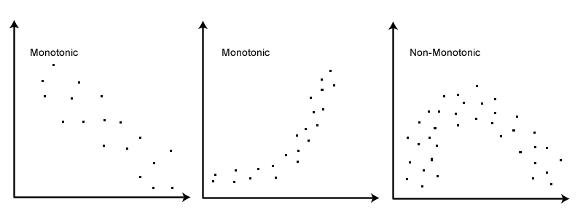

Spearman Correlation
Measures the monotonic behavior relationship between two features
In some way, ‘connects’ between Pearson and Kendall's tau
Definition : $r_{X,Y}= \frac{\sum_{i=1}^{n}{\left(x_{i}−\overline{x}\right)}(y_{i}−\overline{y})}{\sqrt{\sum_{i=1}^{n}{{\left(x_{i}−\overline{x}\right)}^{2}}}∗\sqrt{\sum_{i=1}^{n}{{\left(y_{i}−\overline{y}\right)}^{2}}}}$ (BUT – the $x_{i} \& y_{i }$are the ranked features!)
What about ties?
Range: [-1,1] (what do the -1,0,1 values mean?)
Advantages/disadvantages comparing to Pearson correlation
Notes:
not too sensitive to outliers (advantage)
Go back the SMG example
But – we still give a numeric meaning to the ranking values (there is a big difference to the raking value now)

Slide 16
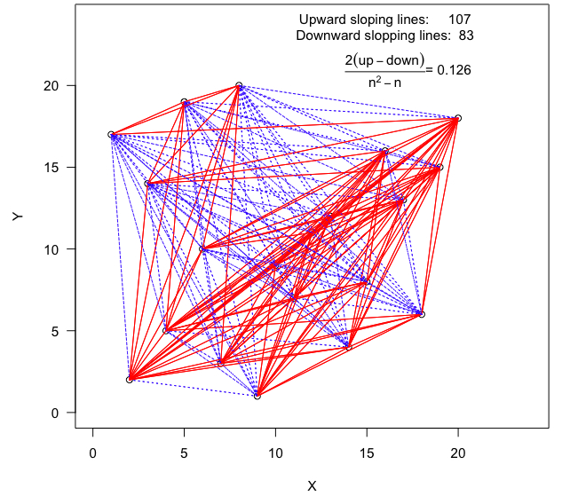
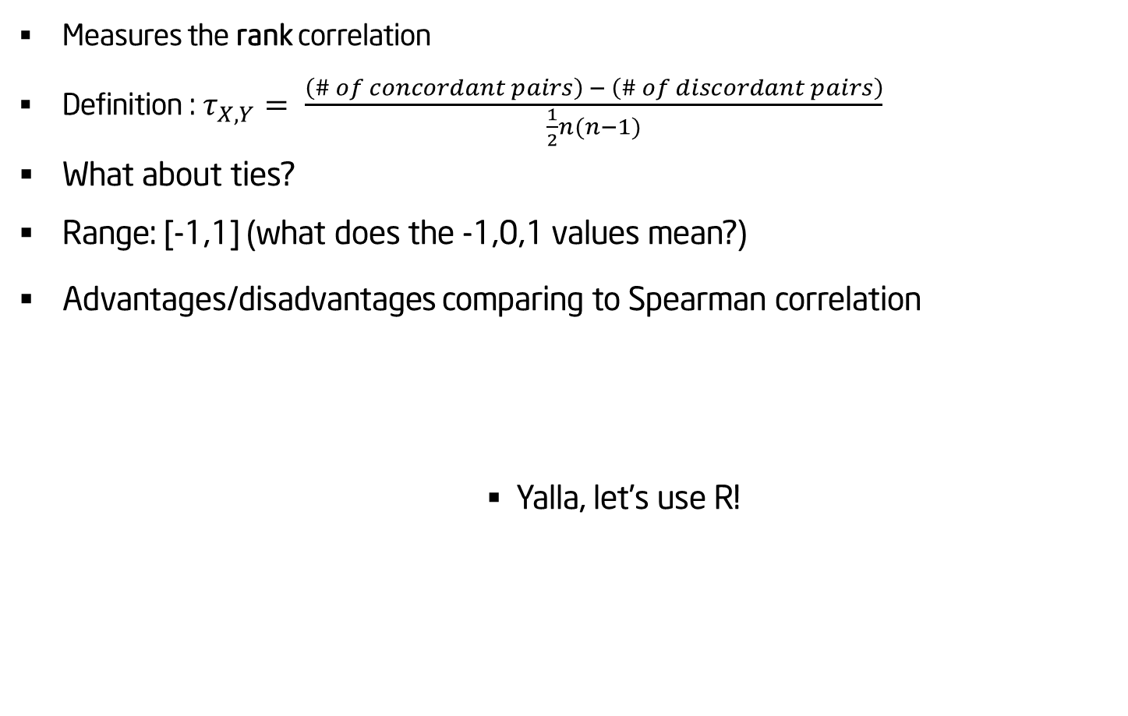
Kendall's Tau Correlation
Measures the rank correlation
Definition : $τ_{X,Y}= \frac{\left(\# of concordant pairs\right) − \left(\# of discordant pairs\right)}{\frac{1}{2}n(n−1)}$
What about ties?
Range: [-1,1] (what does the -1,0,1 values mean?)
Advantages/disadvantages comparing to Spearman correlation
Yalla, let’s use R!
Notes:
Now, we don’t give ANY numeric meaning to the observations
Best way to understand the example – divide the area into 4 quarters and think about each quarter
Advantages/disadvantages – only care about the ORDER between pairs and NOT the rank value itself, not too sensitive to outliers
Example from - http://bmscblog.wordpress.com/2013/02/25/kendall-correlation-coefficient
Example #4 in R

Slide 17
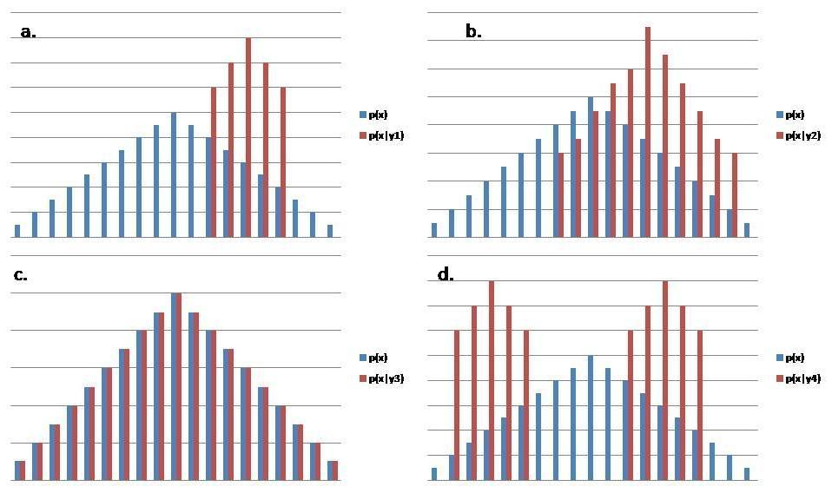
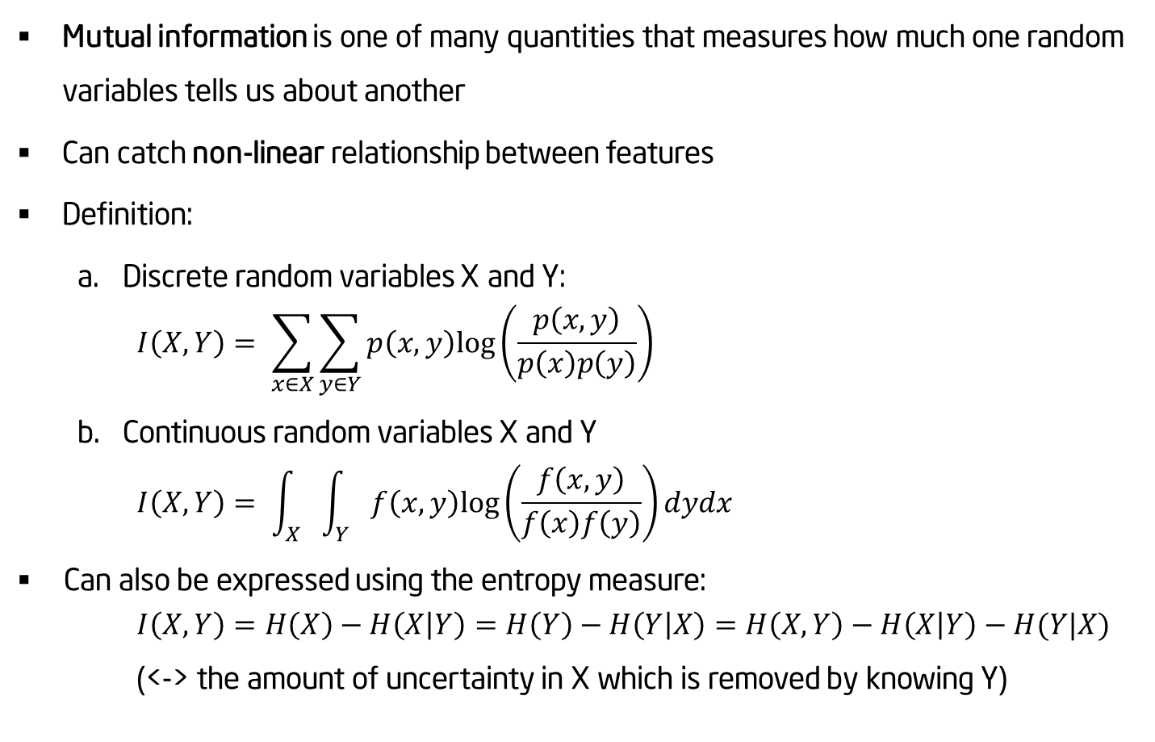
Mutual Information
Mutual information is one of many quantities that measures how much one random variables tells us about another
Can catch non-linear relationship between features
Definition:
Discrete random variables X and Y:
$$I\left(X,Y\right)= \sum_{x∈X}{\sum_{y∈Y}{p\left(x,y\right)log⁡\left(\frac{p\left(x,y\right)}{p\left(x\right)p\left(y\right)}\right)}}$$
Continuous random variables X and Y
$$I\left(X,Y\right)= \int_{X}{\int_{Y}{f\left(x,y\right)log⁡\left(\frac{f\left(x,y\right)}{f\left(x\right)f\left(y\right)}\right)}}dydx$$
Can also be expressed using the entropy measure:
$$I\left(X,Y\right)=H\left(X\right)−H\left(X | Y\right)=H\left(Y\right)−H\left(Y | X\right)=H\left(X,Y\right)−H\left(X | Y\right)−H(Y|X)$$
(<-> the amount of uncertainty in X which is removed by knowing Y)
Notes:
לעמוד על הבעיה שבשימוש בנוסחה למשתנה הרציף
Give an example with a cube
A is the best one, c doesn’t have any value

Slide 18
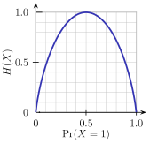
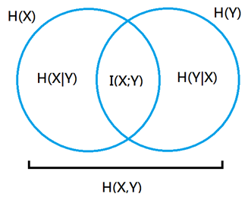
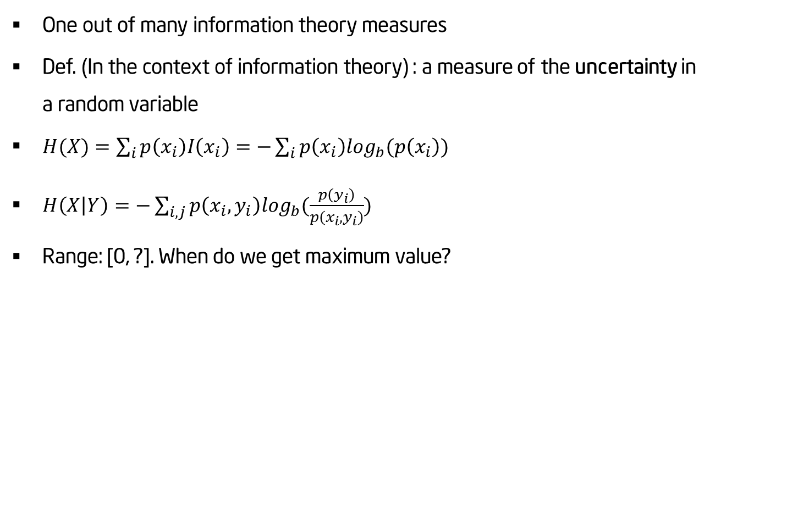
Shannon Entropy
One out of many information theory measures
Def. (In the context of information theory) : a measure of the uncertainty in a random variable
$H(X)=\sum_{i}{p\left(x_{i}\right)I\left(x_{i}\right)=−\sum_{i}{p\left(x_{i}\right)\log_{b}(p\left(x_{i}\right)})}$
$H\left(X | Y\right)=−\sum_{i, j}{p\left(x_{i},y_{i}\right)\log_{b}(\frac{p\left(y_{i}\right)}{p\left(x_{i},y_{i}\right)}})$
Range: [0, ?]. When do we get maximum value?
Notes:
- עניין הנרמול הוא קריטי כאן – בגלל הטווח – איך אפשר לנרמל? 3 דרכים שונות

Slide 19
Correlation and MI
So – when should we use each measure?
Discrete features – MI
Continuous features – Start with correlation
Continuous features – always check MI (what is the most critical decision now?)
In the ‘correlation world’ – which measure to use?
Care about the actual values? If so – Pearson
Care only about the rank of value? If so – Spearman
Care about the order of the value? If so – Kendell's tau
Don’t care? If so – so do I
Notes:
what is the most critical decision now – discretization method
Comparison - http://geoinfo.amu.edu.pl/qg/archives/2011/QG302_087-093.pdf

Slide 20
Agenda
Introduction
Data types
Distance measures
Correlation and Mutual information
Data distribution
Missing values
Outliers
Normalization & Transformation
Discretization
Unbalanced data

Slide 21
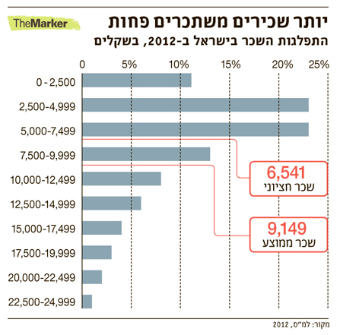
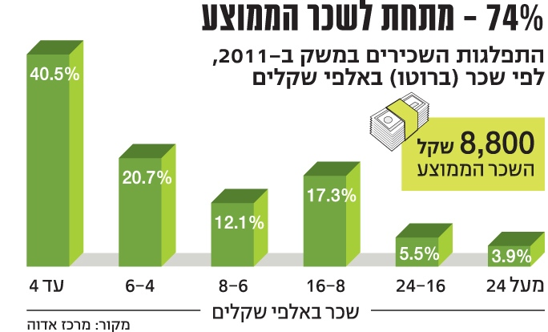

Slide 22
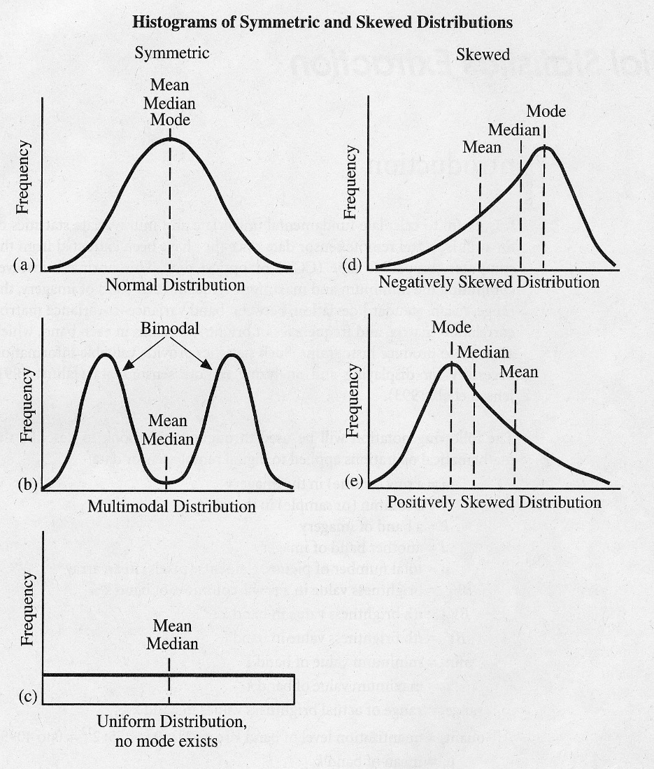
Basic measures (1)
Many statistical tests assume values are normally distributed, but this is not always the case
Examine data prior to processing
Comparing Mean, Median & Mode
Mode (שכיח)
Good for nominal variables
Quick and easy
Median (חציון)
Robust central tendency statistics
Less sensitive to outliers and extreme values
Good for “bad” distributions
Mean (ממוצע)
Most commonly used statistic for central tendency
Generally preferred except for “bad” distribution
Based on all data in the distribution
Used for inference as well as description
best estimator of the parameter
Notes:
Nominal = not numerical (categorical – e.g. gender)

Slide 23
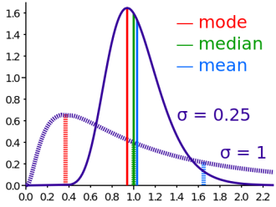
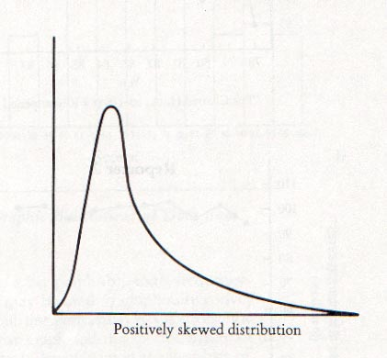
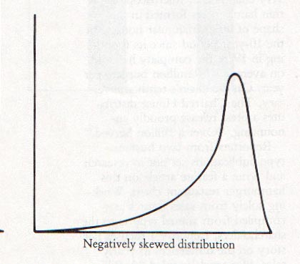
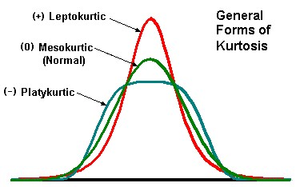
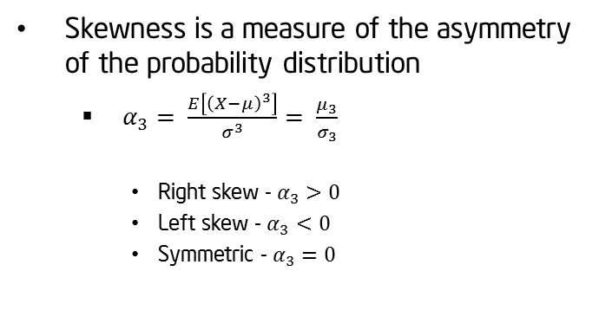
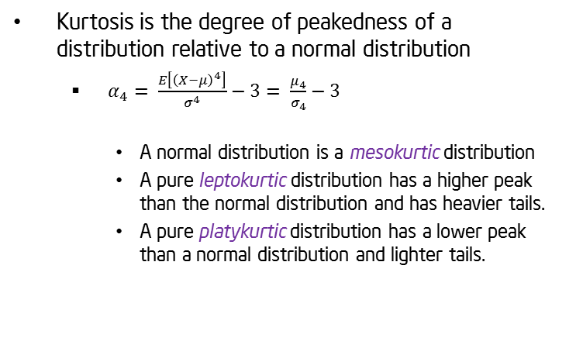
Basic measures (2)
Skewness (tails)
Kurtosis (shoulders, heavy tail)
Skewness is a measure of the asymmetry of the probability distribution
$α_{3}= \frac{E\left[{\left(X−μ\right)}^{3}\right]}{σ^{3}}= \frac{μ_{3}}{σ_{3}}$
Right skew - $α_{3}>0$
Left skew - $α_{3}<0$
Symmetric - $α_{3}=0$
Kurtosis is the degree of peakedness of a distribution relative to a normal distribution
$α_{4}= \frac{E\left[{\left(X−μ\right)}^{4}\right]}{σ^{4}}−3= \frac{μ_{4}}{σ_{4}}−3$
A normal distribution is a mesokurtic distribution
A pure leptokurtic distribution has a higher peak than the normal distribution and has heavier tails.
A pure platykurtic distribution has a lower peak than a normal distribution and lighter tails.
Notes:
דוגמא מס' 5 ב R

Slide 24
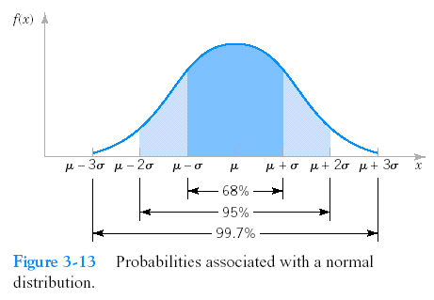
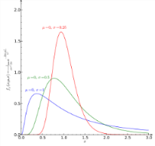
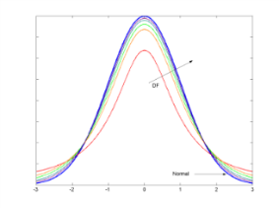
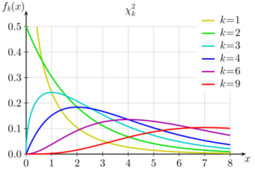
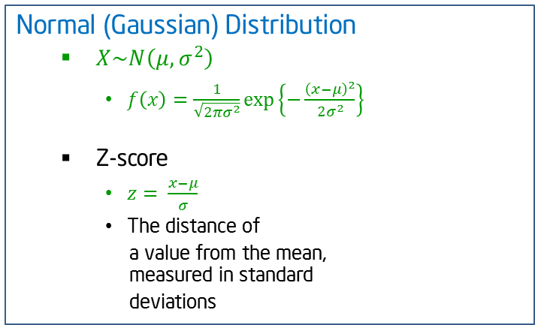
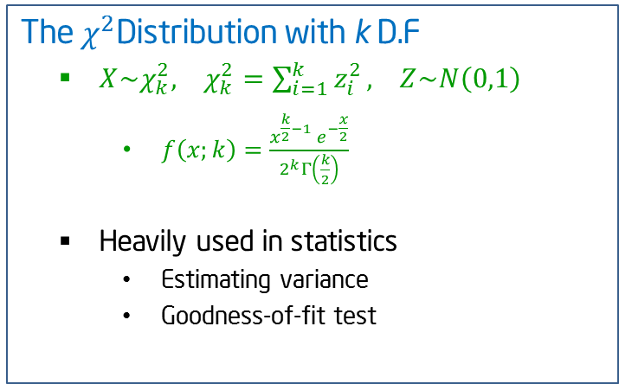
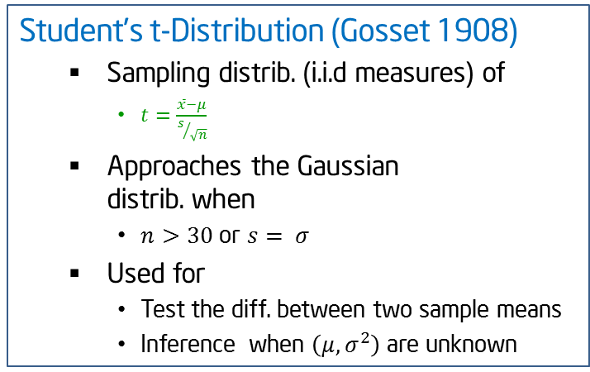
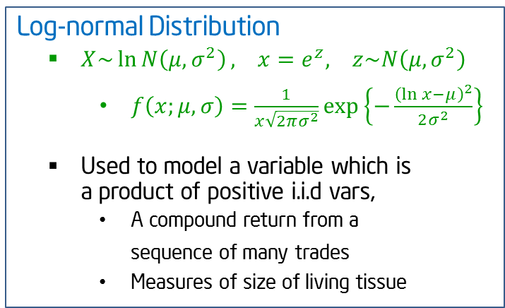
Data distribution (1)
Normal (Gaussian) Distribution
$X\sim N\left(μ,σ^{2}\right)$
$f\left(x\right)=\frac{1}{\sqrt{2πσ^{2}}}\exp\left\{−\frac{{\left(x−μ\right)}^{2}}{2σ^{2}}\right\}$
Z-score
$z= \frac{x−μ}{σ}$
The distance of
a value from the mean, measured in standard
deviations
Log-normal Distribution
$X\sim \ln{N\left(μ,σ^{2}\right)}, x=e^{z}, z\sim N\left(μ,σ^{2}\right)$
$f\left(x;μ, σ\right)=\frac{1}{x\sqrt{2πσ^{2}}}\exp\left\{−\frac{{\left(\ln{x}−μ\right)}^{2}}{2σ^{2}}\right\}$
Used to model a variable which is a product of positive i.i.d vars,
A compound return from a sequence of many trades
Measures of size of living tissue
Student’s t-Distribution (Gosset 1908)
Sampling distrib. (i.i.d measures) of
$t=\frac{\overline{x}−μ}{s/{\sqrt{n}}}$
Approaches the Gaussian distrib. when
$n>30$ or $s= σ$
Used for
Test the diff. between two sample means
Inference when $\left(μ,σ^{2}\right)$ are unknown
The $χ^{2}$Distribution with k D.F
$X\sim χ_{k}^{2}, χ_{k}^{2}=\sum_{i=1}^{k}{z_{i}^{2}}, Z\sim N\left(0,1\right)$
$f\left(x;k\right)=\frac{x^{\frac{k}{2}−1} e^{−\frac{x}{2}}}{2^{k}Γ\left(\frac{k}{2}\right)}$
Heavily used in statistics
Estimating variance
Goodness-of-fit test
Notes:
התפלגות טי מאוד דומה לנורמליץ, יש לה זנב ארוך יותר והיא משמשת בעיקר למבחני השערה ובדיקת תוחלות ושונויות. טובה כאשר ממצוע ושונות לא ידועים, בגלל שאז צריך רק לאמוד את דרגות החופש
לא מדברים כאן על התפלגות אקספוננציאלית, אבל היא גם חשובה

Slide 25
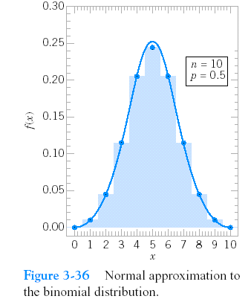
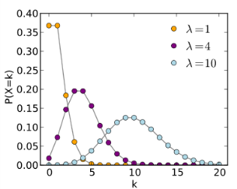
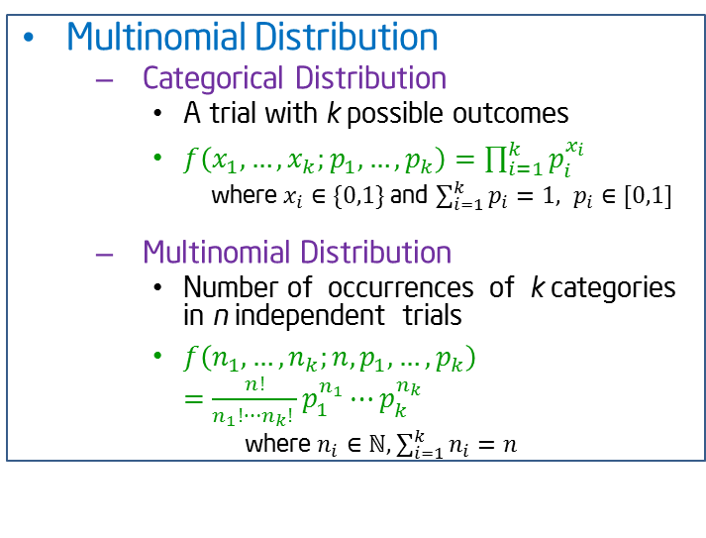
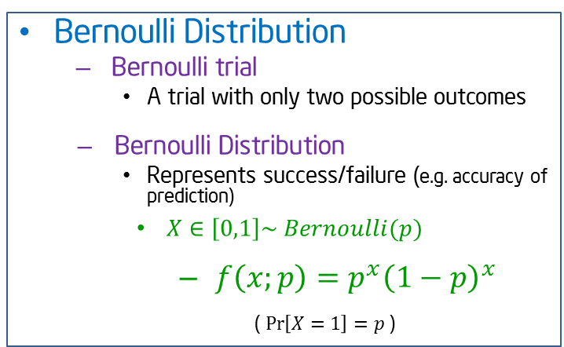
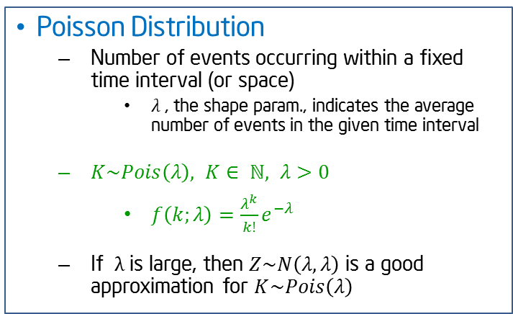
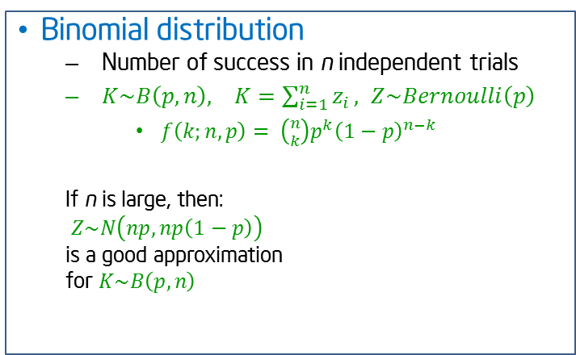
Data distribution (2)
Bernoulli Distribution
Bernoulli trial
A trial with only two possible outcomes
Bernoulli Distribution
Represents success/failure (e.g. accuracy of prediction)
$X∈\left[0,1\right]\sim Bernoulli(p)$
$f\left(x;p\right)=p^{x}{\left(1−p\right)}^{x}$
( $\operatorname{Pr}\left[X=1\right]=p$ )
Binomial distribution
Number of success in n independent trials
$K\sim B\left(p,n\right), K=\sum_{i=1}^{n}{z_{i}}, Z\sim Bernoulli\left(p\right)$
$f\left(k;n,p\right)= \left({n \atop k}\right)p^{k}{\left(1−p\right)}^{n−k}$
If n is large, then:
$Z\sim N\left(np,np\left(1−p\right)\right)$
is a good approximation
for $K\sim B\left(p,n\right)$
Multinomial Distribution
Categorical Distribution
A trial with k possible outcomes
$f\left(x_{1},…,x_{k};p_{1},…,p_{k}\right)=\prod_{i=1}^{k}{p_{i}^{x_{i}}}$
where $x_{i}∈\{0,1\}$and $\sum_{i=1}^{k}{p_{i}}=1, p_{i}∈[0,1]$
Multinomial Distribution
Number of occurrences of k categories in n independent trials
$f\left(n_{1},…,n_{k};n,p_{1},…,p_{k}\right)=\frac{n!}{n_{1}!⋯n_{k}! }p_{1}^{n_{1}}⋯p_{k}^{n_{k}}$
where $n_{i}∈ℕ,\sum_{i=1}^{k}{n_{i}=n}$
Poisson Distribution
Number of events occurring within a fixed time interval (or space)
$λ$ , the shape param., indicates the average number of events in the given time interval
$K\sim Pois\left(λ\right), K∈ ℕ, λ>0$
$f\left(k;λ\right)=\frac{λ^{k}}{k!}{e^{−λ}}$
If $λ$ is large, then $Z\sim N\left(λ,λ\right)$ is a good approximation for $K\sim Pois\left(λ\right)$
Notes:
אפשר להזכיר את הקשר שבין התפלגות פאוסונית לבין התפלגות אקספוננציאלית

Slide 26
Testing the data distribution
Parametric Hypothesis and general test
Statistical tests to check the mean/variance
Q-Q plot
Testing a general distributions
Shapiro's test for normality
Kolmogorov–Smirnov test
Cramér–von Mises criterion
Anderson–Darling test
Notes:
Shapiro's test for normality – good also for small data sets
Cramér–von Mises criterion – also comparing distributions, but by the integral of differences between the cumulative functions
Anderson–Darling test – similar to the others, but taking a different measure of distances
להראות דוגמא ב JMP

Slide 27
Testing the data distribution
Data comparisons you are making | Data are normally distributed | Data are not normally-distributed, or are ranks or scores | Data are Binomial (Possess 2 possible values)
Compare one set of data to a hypothetical value | One-sample t-test | Wilcoxon test | χ² test
Compare two sets of independently-collected (unpaired) data | Unpaired t-test | Mann-Whitney test | χ² test or Fisher test
Compare two sets of data from the same subjects under different circumstances (paired) | Paired t-test | Wilcoxon test | McNemar’s test
Compare three or more sets of data | One-way ANOVA | Kruskal-Wallis test | χ² test
Look for a relationship between two variables | Pearson Correlation coefficient | Spearman correlation coefficient | Contingency Correlation coefficients
Look for a linear relationship between two variables | Linear regression | Nonparametric linear regression | Simple logistic regression
Look for a non-linear relationship between two variables | Non-linear regression | Nonparametric non-linear regression
Let’s see some examples how to run these tests

Slide 28
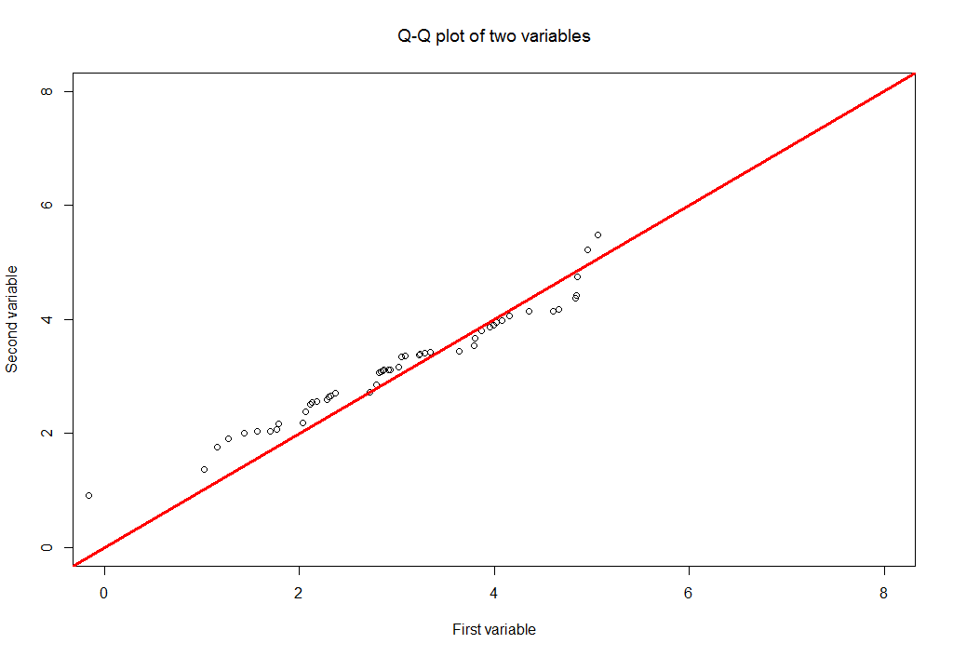
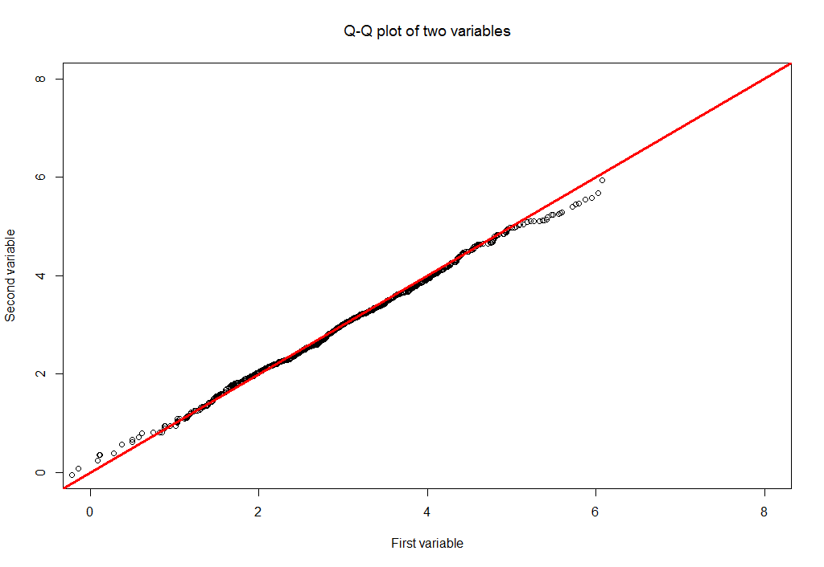
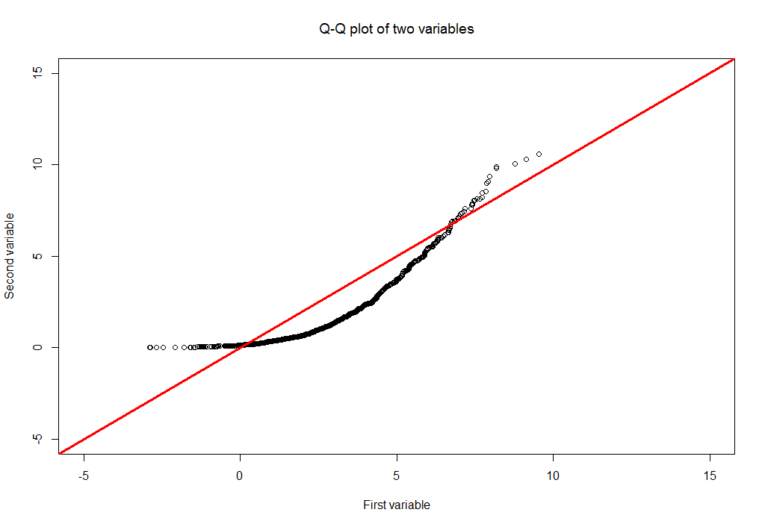
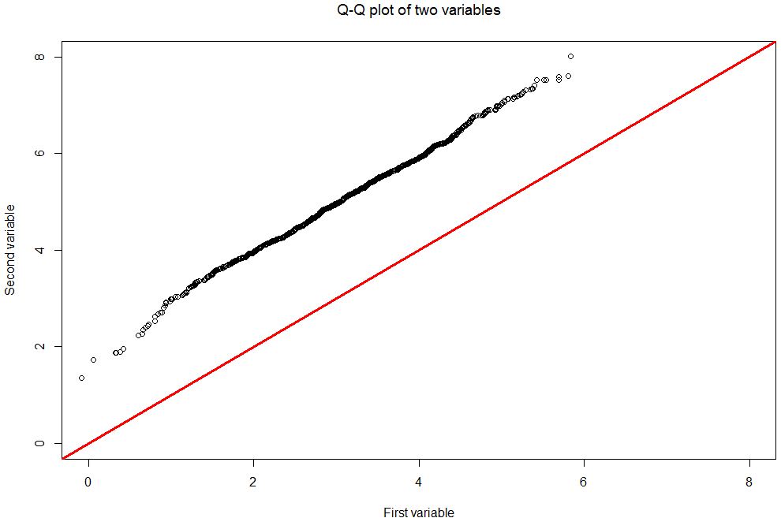
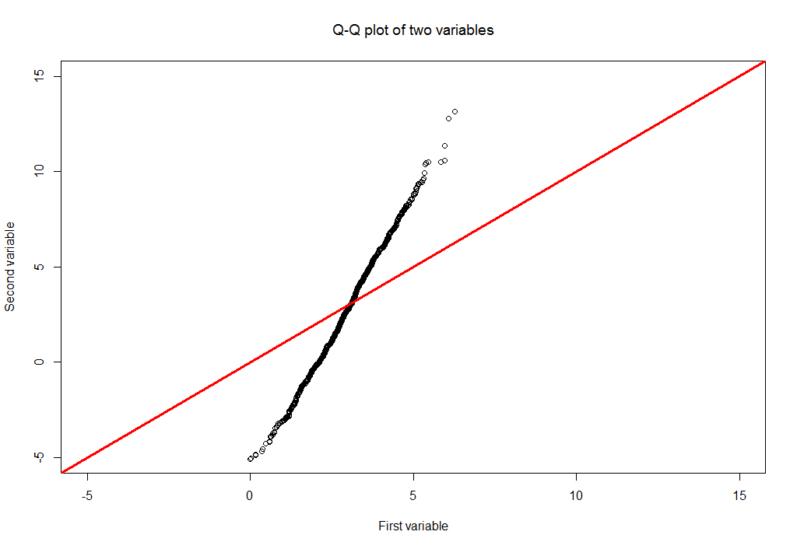
Q-Q plot
A plot of the quantiles of the first data set against the quantiles of the second data set
Data sets sizes don’t have to be equal
The greater the departure from the 45 deg. reference line, the greater the evidence for the conclusion that the two data sets have come from populations with different distributions
Notes:
- דוגמא מס' 6 ב R

Slide 29

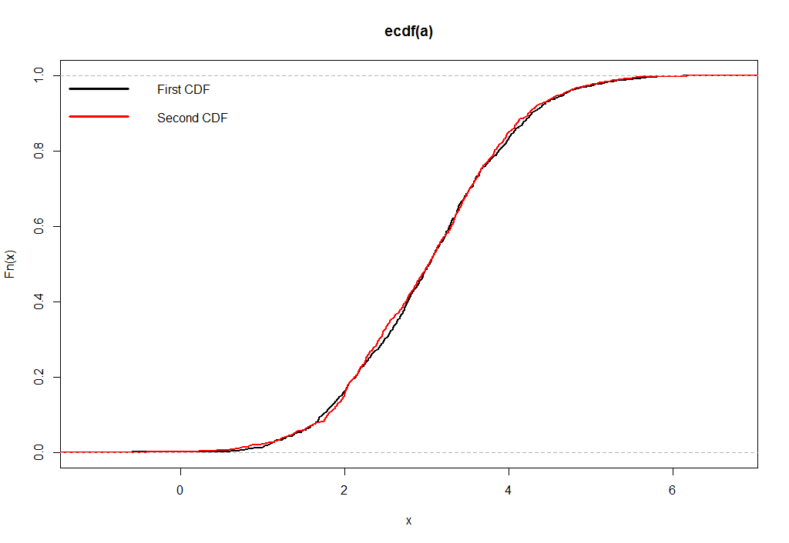
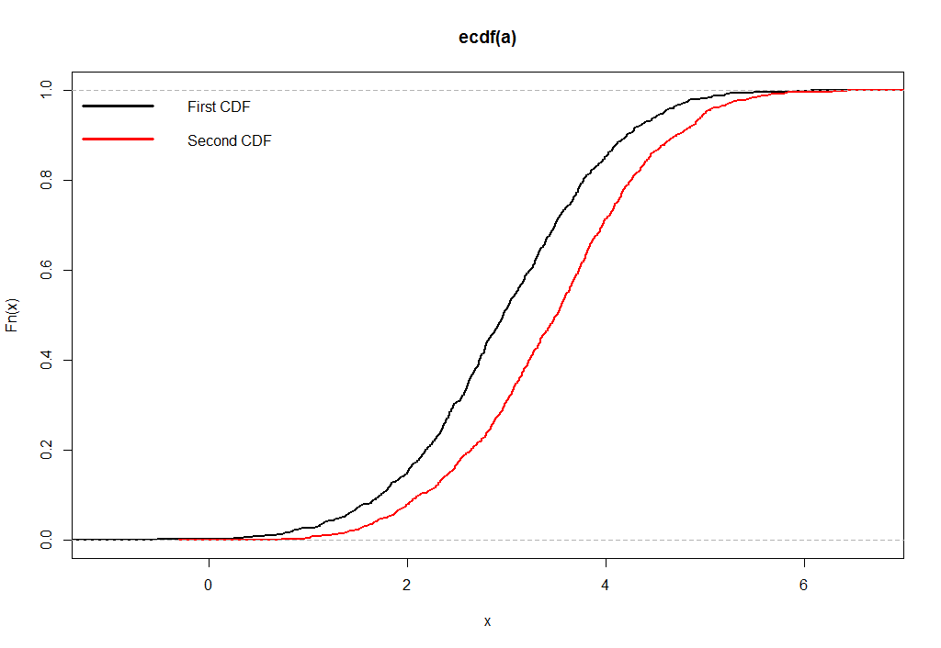
Kolmogorov–Smirnov test
A non-parametric test for the equality of continuous, one-dimensional probability distribution
Can be applied to test a dataset distribution against a known distribution OR against another dataset distribution
The K-S statistics is defined as:
Let’s have an example in R
H₀: | The data follow a specified distribution
H₁: | The data does not follow a specified distribution
Notes:
Chi-square maybe here – best for categorical features
דוגמא מס 6 ב R

Slide 30
Agenda
Introduction
Data types
Distance measures
Correlation and Mutual information
Data distribution
Missing values
Outliers
Normalization & Transformation
Discretization
Unbalanced data

Slide 31

Missing values handling (1)
We don’t always need to handle missing value
But when we do…
Any ideas?
Notes:
Not always we should fill in missing values – sometimes is has meaning.
This is critical – we must make sure that it is “missing by random” (CMBR)
Many models wont run without filling in missing values
We should think about if we want to fill in the missing data based on train/test/both

Slide 32
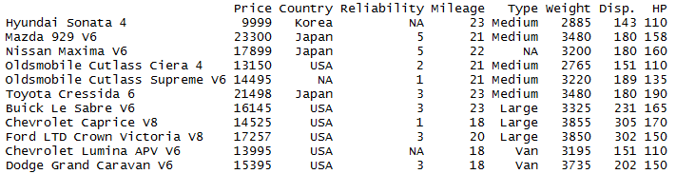
Missing values handling (2)
Ignore the entire tuple/feature
Simple
Reduces statistical power, estimation might be biased if data is missing on purpose.
Notes:
Can cause a real bias
Changing the entire distribution of the data

Slide 33
Missing values handling (3)
Analyze only cases in which the relevant variables are present (Pairwise deletion)
Uses all possible information with each analysis
Notes:
Remind the distance measure – for example we can use it in clustering. Wont be a solution in cases of LM
This is שיפור in regards to the last method, but remember that if the NA was meant to be an NA – we are missing useful info

Slide 34
Missing values handling (4)
Use attribute mean, median or mode to complete the missing data
Mean (Reliability): (5+5+2+1+3+3+1+3+3)/9 = 2.88
Median (Reliability): 1 1 2 3 3 3 3 5 5
Mode (Country): USA = 6, Japan = 3, Korea = 1.

Slide 35
Missing values handling(5)
Use attribute mean, median or mode to complete the missing data – restricted to a class
Class
A
A
A
A
B
B
B
B
C
C
C
Hyundai.Mean (Reliability): (5+5+2)/3 = 4
Hyundai.Median (Reliability): 2 5 5
Oldsmobile cutlass supreme.Mode (Country): USA = 2, Japan = 1
Notes:
Useful when you have a class you can trust on (best would be a target class)

Slide 36

Missing values handling (6)
Sampling
If distribution is known, sample from it
Else, sample from all possible values
Sampling from related class (as seen in previous slide)
Notes:
If we won’t have a distribution – we will sample from the numbers we have (ONLY) – disadvantage

Slide 37


Missing values handling (7)
Sampling (cont.)
So – how does the sampling “algorithm” works?
Generate random number c=rand() (uniform [0,1])
Find the cumulative distribution function (F(b)) (remember, )
Calc b=F⁻¹(c)
E.g. exponential distribution y=F(x)=1-e^{-λx} x=log(1-y)/(-λ)
Same with discrete values (staircase function)
Notes:
If we won’t have a distribution – we will sample from the numbers we have (ONLY) – disadvantage

Slide 38
Missing values handling (8)
Use global closest fit to K nearest neighbors (take the value from the closest tuple.
If K > 1, you can use either mean, median, mode or sampling to select the best fit.

Slide 39
Missing values handling (9)
EM (Expectation-Maximization) algorithm
Replace each missing value by an estimate (conditional expectation)
Then estimate the parameters (data distribution parameters) using the new “complete data”
Continue until converged…
Notes:
צורת פתרון שלא דווקא רלוונטית להשלמת ערכים חסרים, אלא גם לקלסטרניג למשל
דוגמא מס 7 ב R

Slide 40
Agenda
Introduction
Data types
Distance measures
Correlation and Mutual information
Data distribution
Missing values
Outliers
Normalization & Transformation
Discretization
Unbalanced data

Slide 41

Outliers (1)
Definition (Wikipedia): “An observation point that is distant from other observations. An outlier may be due to variability in the measurement or it may indicate experimental error”
Lets see an introduction example in R
Notes:
- דוגמא מס 8 ב R

Slide 42
Outliers (2)
Identifying observation as an outlier:
Distance based Methods (e.g. +- 3*SD)
Statistical Methods
Formal outlier tests
Differ in their distributional model
Usually assume approximately normal
Univariate VS Multivariate
A single outlier VS multiple outliers tests
OK – what should we do with these outliers??
Notes:
- שיטות מרחק– בוקס פלוט
מה עושים איתם – לרוב או מעיפים לגמרי, או ממשקלים בצורה שונה את התצפיות
שיטה נוספת שלא נרחיב עליה - IQR - אפשר לראות הסבר פה http://www.statisticshowto.com/what-is-an-iqr/

Slide 43

Outliers - Univariate (3)
Grubbs’ Test (outlier test for normal univariate data)
Test for a single outlier
H₀: There is no outlier in data
H_{A}: There is one outlier
Grubbs’ test statistic
The largest absolute deviation from the sample mean in units of the sample standard deviation s
$$G= \frac{\max_{i}\left|X_{i}−\overline{X}\right|}{s}$$
Critical region for significance level $α$
Reject H₀ (the hypothesis of no outliers), if
$$G> \frac{N−1}{\sqrt{N}}\sqrt{\frac{t_{\left(α/{2N},N−2\right)}^{2}}{N−2+t_{\left(α/{2N},N−2\right)}^{2}}}$$
Notes:
Assume normal distribution
High p-values = we’ll

Slide 44

Outliers - Univariate (4)
Rosner Test (outlier test for normal univariate data)
Test for multiple outliers by sequentially applying Grubbs’ Test
Detect one outlier at a time, remove the outlier, and repeat
Critical region for significance level $α$, at iteration $i$
$$λ_{i}=\frac{N−i}{\sqrt{N−i+1}}\sqrt{\frac{t_{\left(p,N−i−1\right)}^{2}}{N−i−1+t_{\left(p,N−i−1\right)}^{2}}}$$
Where $p=1−α/{2\left(N−i−1\right)}$
All (adjusted) test statistics and critical values are being calculated up to a predetermined upper bound
The number of outliers is determined by the largest $i$ such that the test statistics is larger than $λ_{i}$
Notes:
לשאול בסוף הסלייד – אז מה הבעיה העיקרית עם ההצעות האלו?? הבעיה היא שאנו מסתכלים בחד מימד

Slide 45
Outliers - Multivariate (5)
Nearest Neighbors based approaches
Compute the distance between every pair of data points
There are various ways to define outliers
Density
Data points for which there are fewer than p neighbors within a distance D
Distance
The top n data points whose distance to the k^{th} nearest neighbor are the greatest
The top n data points whose average distance to the k nearest neighbors are the greatest
Local Outlier Factor (LOF)
Based on a concept of a local density, where locality is given by k nearest neighbors, whose distance is used to estimate the density
Compare the local density of an object to the local densities of its neighbors
Class Outlier Factor (COF)
A class restricted distance approach
Notes:
מספר 2 – שתי אופציות הנבדלות באיזו פונקציה על פונקציית המרחק אנחנו משתמשים
שיטה 3 – אלו כבר שיטות של ממש anomaly detection פונקצית המרחק משמשת אותנו כדי לאמוד את הצפיפות. צריך לדבר גם על איך משווים צפיפויות
שיטה 4 – כמו השיטה הקודמת
אפשרויות נוספות – one class svm

Slide 46

Outliers - Multivariate (6)

Slide 47
Agenda
Introduction
Data types
Distance measures
Correlation and Mutual information
Data distribution
Missing values
Outliers
Normalization & Transformation
Discretization
Unbalanced data

Slide 48
Normalization (1)
AKA Feature Scaling
Why do we need normalize the data?
Easy comparison of values
In some algorithms, objective functions will not work properly (or quick) without it
Example:
Predict the cost of the house, giving it’s size (squared meters) and the # of bedrooms
40
200
1
7
Notes:
Many times it is important only because of performance. It is critical when we deal with distance function
Again the q – do we normalize based on train/test/all?
Example – sacle of bedrooms VS the sq of the house (not talking in same scale)

Slide 49


Normalization (2)
Min/Max normalization to [0,1]
Min/Max normalization to [-1,1] (if we want 0 to be the central point)
1
7
40
200
0
1
1
7
40
200
-1
1
Notes:
Litan – fix the picture below

Slide 50


Normalization (3)
Standardization (Z – normalization).
using mean and standard deviation. Fits normalized-like data.

Slide 51
Normalization (4)
Log normalization
Used when values are ranged over several orders of magnitude.
X’ = a*log_{b}(X)
Notes:
In weight loss (when trying to set how many kg’s to drop, 80KG is pretty much the same as 100KG.

Slide 52
Normalization (5)
But… which normalization method to use?
Notes:
Finger rule…. The larger the entropy (the variable spread out more uniform), the better to use [0,1] normalization. As it going smaller, use z normalization.
Another option – the Kurtosis measure (as it is smaller – use 1,-1

Slide 53
Transformations
Transformation examples – log(X), 1/X, X^2 etc…. Can lead us to non-linear models
Let’s see an example
Notes:
- דוגמא מס 9 ב R

Slide 54
Agenda
Introduction
Data types
Distance measures
Correlation and Mutual information
Data distribution
Missing values
Outliers
Normalization & Transformation
Discretization
Unbalanced data

Slide 55
Discretization (1)
Why do we need to change the data?
Some models/measures can’t handle continuous values (i.e. Naïve Bayes, MI)
Some numeric values don’t have a meaningful numeric insights (but when taking them as discrete ones – they do have)
The business might have useful information to give us.
Notes:
Discretization = kind of histogram calculation
Exmple to the seond bullet – radios of the unit in manufactoring
Not only to data רציף

Slide 56

Discretization (2)
Equal-width (distance) partitioning
Divides the range into N intervals of equal size: uniform grid
if A and B are the lowest and highest values of the attribute, the width of intervals will be: W = (B –A)/N.
The most straightforward, but outliers may dominate presentation
Skewed data is not handled well
Notes:
Which value is assigned to each interval

Slide 57
Discretization (3)
Equal-depth (frequency) partitioning
Divides the range into N intervals, each containing approximately same number of samples
Good data scaling
Managing categorical attributes can be tricky
Notes:
כלל האצבע כאן – כל חלק מכיל מספר שווה של תצפיות

Slide 58
Discretization (4)
Entropy based
The entropy (or the information content) is calculated on the basis of the class label.
Intuitively, it finds the best split so that the bins are as pure as possible, i.e. the majority of the values in a bin correspond to having the same class label.
Formally, it is characterized by finding the split with the maximal information gain.
Notes:
מקביל לעץ החלטה עם מספר פיצולים על אותו משתנה מסביר
לחזור לדוגמא של התאונות ב R

Slide 59
Agenda
Introduction
Data types
Distance measures
Correlation and Mutual information
Data distribution
Missing values
Outliers
Normalization & Transformation
Discretization
Unbalanced data

Slide 60
Unbalanced data (1)
"Unbalanced" is difficult to define precisely
Generally speaking - unequal numbers of observations in each category (usually related to classification problems)
Usually talking about the unbalanced regarding the target data – but not always!
Examples:
medical diagnosis: 90% healthy, 10% disease
eCommerce: 99% don’t buy, 1% buy
Defects in the manufacturing process
Easily we can build an amazing model
Notes:
Sometimes the unbalanced in the משתנה מסביר is a very important thing to notice (usually, we wont change the data due to this issue)

Slide 61

Unbalanced data (2)
Stratified Sampling – sampling technique in which each subpopulation (stratum) is sampled independently
Ensure that each class is represented with approximately equal proportions in train and test
Estimate the final results using an imbalanced held-out (test) set
How to create a “balanced” dataset?
Down-sample the large classes
Use when majority is very large and minority is extremely small
Bootstrap the smaller classes
Use when minority size is large enough to safely resample
Assign weights to the samples
A commonly used weighting scheme: is $w_{c}=\frac{n}{n_{c}}$
Where $n_{c}$ is the size of the class c and $n=\sum_{c}{n_{c}}$ is the total sample size
Notes:
Down sample – TOMEC

Slide 62

Summary
Topics we have covered
How CRISP-DM is related to the session
In practice – what is being done in real life
Anything else?

Slide 63
Backup

